Slide 1
CHAPTER THREE
SYSTEM ANALYSIS

Slide 2
System Analysis
is the study of a business problem for the purpose of recommending improvements and specifying the business requirements for the solution
It has three parts:
Determining Requirements
Structuring Requirements
Selecting the best alternative design strategy
These steps are may be parallel and repetitive
1 .Requirement Determination
Requirement determination means gathering information on what the system should do from as many sources as possible.
Analysts use system requirement determination to:
Understand current problems and opportunities
As well as what is needed and desired in future systems.

Slide 3
Requirement Determination is collecting and organizing users requirement- WHAT- User needs?
What is a Requirement ?
It is a statement describing either
an aspect of what the proposed system must do, or
a constraint on the system’s development.
In either case it must contribute in some way towards adequately solving the customer’s problem;
The set of requirements as a whole represents a negotiated agreement among the stakeholders.
A collection of requirements is a requirements document.

Slide 4
Types of Requirements
Functional requirements
Describe what the system should do
Non-functional requirements
Quality requirements
Constraints on the design to meet specified levels of quality
Pseudo requirements
Platform requirements
-Constraints on the environment and technology of the system
Process requirements
-Constraints on the project plan and development methods

Slide 5
Functional Requirements
What inputs the system should accept?
What outputs the system should produce?
What data the system should store that other systems might use?
What computations the system should perform?
The timing and synchronization of the above
Non-Functional Requirements
Sometimes referred to as technical requirements or quality requirements of the system.
The technical or quality issues to be addressed here are more on:
Maintainability- Software must evolve to meet changing needs
Dependability-software must be trustworthy

Slide 6
Acceptability (meet users requirement)
- Software must accepted by the users for which it was designed.
- This means it must be understandable, usable and compatible with other systems
Efficiency-software should not make wasteful use of system resources
Portability (across operating systems)
Testability
Usability
Users can learn it and fast and get their job done easily
Reliability
It does what it is required to do without failing
Reusability
Its parts can be used in other projects, so reprogramming is not needed

Slide 7
User Interface and Human Factors, Documentation
Hardware Considerations
Performance Characteristics
Error Handling and Extreme Conditions
Quality Issues, Resources and Management Issues, etc
Generally Requirement Determination(Gathering):
Is about a communication b/n developers and user in defining a new system
Failure to do so will lead to “unwanted” system
Errors introduced at this stage are expensive system
Focus on describing the purpose of the system
Results in system specification

Slide 8
The users requirement is mainly gathered based on traditional and modern methods of gathering users requirement.
All the system requirements are carefully documented and made ready for structuring.
1.Traditional Methods for Gathering Requirements
The traditional ways to get information directly from those who have the information is by conducting interviews, questionnaires and direct observation.
A) Interviewing
The system analyst has to spend a large amount of time in interviewing the people about
Their work
The information they use to do it and
The types of information processing that might supplement their work

Slide 9
Other people are too interviewed to understand organizational direction, policies and expectations that managers have on the units they supervise.
The facts, opinion and speculation (rumor) are gathered, the body language, emotions and other signs of what people want and how they assess current systems.
SA can sometimes determine if people are answering truthfully or fully by the words they use, whether they make direct eye contact, the tone of voice they use or their body language.
The following are the most common steps that take place during the interviewing process.
1. Determining the People to Interview
You need to determine the people that can best satisfy the answers to your questions.

Slide 10
Organisational charts and job specifications can help to identify appropriate people to interview.
2. Establishing Objectives for the Interview
Need to be clear about what your objectives are for the interview.
To do this, you should determine the general areas to be discussed, then list the facts that you want to gather.
The objectives of the interview will depend on the role of the person being interviewed.
Upper management provides a "big picture" or overview which will help you understand the system as a whole.
Specific details about operations and business processes are best learned from people who actually work with the system on a daily basis.

Slide 11
3. Developing the Interview Questions
Creating a list of questions helps you keep on track during the interview.
It is appropriate to include open and closed questions during the body of the interview.
Open-ended questions in interviews and on questionnaires that have no pre-specified answers.
The advantages of open-ended questions:
Previously unknown information can surface, and interviewee may get more of a sense of involvement and control in the interview.
The major disadvantage of open-ended questions in the length of time it can take for the questions to be answered.
Closed-ended questions provide a range of answers from which the interviewee may choose.

Slide 12
These sort of questions works well when the major answers to questions are well known.
Another plus is that interviews based on these questions do not require a large time.
The major disadvantage of closed-ended questions is that
Useful information that does not quite fit the defined answers may be overlooked as the respondent tries to make a choice instead of providing his or her best answers.
4. Preparing for the interview
Preparation is the key to a successful interview.
It is often easy to detect an unprepared interviewer.
The interviewee is providing their valuable time, so you, as the interviewer, must be prepared.

Slide 13
The interviewer should book and confirm their appointment times and venue.
In addition, the goals or subject matter of the interview should be communicated to the interviewee.
5. Conducting the interview
An interview can be characterised as having three phases: the opening, the body and the conclusion.
During the interview opening, the interviewer should:
Explain the reason for the interview,
what the interviewer expects to get out of the interview,
Motivate the interviewee to contribute to the interview.
The interview body represents the most time-consuming phase where you obtain the interviewee's responses to your questions and focus on your well-defined objectives.

Slide 14
Most interviewees will expect or at least permit you to take notes.
Some interviewers use audio note-takers.
While this can capture the entire interview, some interviewees may be hesitant to express their opinions if they know that they have been recorded on tape.
The interview conclusion allows you to summarise your understanding of the data gathered during the interview.
You should express your appreciation for the interviewee's valuable time and instil a sense of value for the interviewee.
You may need to follow-up with more questions, so the conclusion is an important time to develop rapport and trust with the interviewee.

Slide 15
6. Documenting the interview
Transcribe your notes into a format that allows you to understand the information gained at the interview.
Sometimes, in experienced interviewers do not capture the interview in writing until some time after the interview.
In these cases, the interviewer may lose many of the valuable facts gained in the interview.
Some interviewees request copies of the interview transcript.
This can be helpful in prompting the interviewee to volunteer information inadvertently omitted in the interview.
7. Evaluating the interview
It is important to review your notes and transcript to identify any areas of problem, bias or errors.
The review may prompt further questions that need to be answered.

Slide 16
Interview Guidelines
1. Don’t phrase a question in a way that implies a right or wrong answer.
Enable the respondents to feel free to tell their true opinions and perspectives and make them to trust that their ideas will be considered carefully.
2. Listen carefully to what is being said, take notes, or if possible record the interview with their permission. Schedule follow ups.
3. Once the interview is over, key in or document it within 24 hours, otherwise your memory of the interview will fade quickly.
Organize the notes, write down the additional questions that might arise from lapses in the document or ambiguous information.

Slide 17
Separate facts from your opinions and interpretations.
Make a list of unclear points that need clarification.
Call the person and get answers to these questions.
You may send a written copy of your notes to the person you interviewed to check for accuracy.
Make sure to thank the person for his or her time.
4. Be careful during the interview not to set expectations about the new or replacement system unless you are sure these features will be part of the delivered system.
Let the interviewee understand the steps to the project.
Due to the repetitive nature of the systems development process, it is premature to say now exactly what the ultimate system will or will not do.

Slide 18
5. Seek a variety of perspectives from different people:
Potential users of the system, users of other system that might be affect by this new system, managers, superiors, information systems staff and others.
Encourage people to think about current problems and opportunities and what new information services might better serve the organization.

Slide 19
B) Questionnaires
Questionnaires have the advantage of gathering information from many people in a relatively short time.
Interviews are quite expensive and time-consuming process, but the questionnaires are not expensive.
Questionnaires are passive and often yield less rich information than interviews.
Questionnaires are most useful in the requirements determination process when used for very specific purposes rather than for more general information gathering.
1. Choosing Questionnaire Respondents
It must be decided which questionnaire to be given to which group of people.
It should be send to representatives of all users.

Slide 20
The representatives can be selected by any one or combination of these following
Those convenient to sample: The people those willing to be surveyed, or those most motivated to respond.
A random group: the nth person of all users list can be chosen randomly
A purposeful sample: Only people who satisfy certain criteria, such as users of the system.
2. Designing Questionnaires
Questionnaires are less expensive means that the people can complete the questionnaire without help.
Also answers can be provided at the convenience of the respondent.
Questionnaires may include closed-end questions and open-end questions.
Preferably closed-end questions, because they are easier to complete and they define the exact coverage required

Slide 21
A few open-ended questions give the person being surveyed an opportunity to add insights not anticipated by the designer of the questionnaire.
The questions must be extremely clear in meaning and logical in sequence, without ambiguity in question and answers.
Choosing between Interviews and Questionnaires
The interviews are good tools for collecting rich, detailed information and that interview allow exploration and follow-ups but quite time intensive and expensive.
The questionnaires are inexpensive and take less time, as specific information can be gathered from many people at once but the information gathered is less rich and follow up questions is more difficult as it often involves interview or phone calls

Slide 22
These differences are important to remember during the analysis phase.
Deciding which method to use and what strategy to employ to gather information will vary with the system being studied and its organizational context.

Slide 23
C) Direct Observation
It is also possible to gather information about a system by watching the users of the system at work.
This method can bring more objective information - as the analyst can see what the person does (behavior), rather than what they say they do.
This can be used to supplement or confirm the information obtained by asking questions.
Observation can take place in two ways:
By the analyst participating in the user’s work Ex. becoming a member of the team for a week
By watching the users at work – this can be done in person or by video camera.
The advantages of observation over asking questions is that the analyst can see what the user’s behavior and interactions with the system actually are, not what they say they are.

Slide 24
There are also disadvantages to observation :
While being observed, people may not behave normally ( if they know they are being observed) – they may change their behavior.
Also the time at which the observation takes place may mean that the analyst sees only a small subset of the work done by the user.

Slide 25
D) Analyzing Existing Documents ( Reports, Forms, Procedures and Manuals)
Another way to gather information about the current system or possible improvements to it is to review and analyze existing documentation
This can provide information about :
Problems with existing systems (Ex. Missing information, redundant steps)
Possible new features that can be added to existing systems, if certain new information is now available (Ex. analysis of sales based on customer type)
Special Circumstances that occur irregularly but may not be identified by any other requirements gathering technique(Ex. if special handling is required for a few very large volume customers, where customized customer ordering procedures are required)

Slide 26
Data definitions, rules for processing data (Business rules) in the system.
Relevant type of documentation include:
Written work procedures for an individual role or a work group
Business forms
Reports generated by current systems
Documentation about current computer systems

Slide 27
2. Modern Methods for Gathering Requirements
The modern methods are additional techniques to collect information about the:
Current system(existing system)
Organizational area requesting the new System
What the new system should be like
The modern methods are Joint Application Design and Prototyping.
These techniques reduces the time of collecting and structuring the requirements.
2.1 Joint Application Design (JAD)
JAD is a means to bring together the key users, managers, and systems analysts involved in the analysis of a current system.

Slide 28
The goal of JAD is to collect systems requirements simultaneously from the key people involved in the system.
JAD sessions are usually conducted in a location away from where the people normally work, to keep them away from all distractions , so that they can concentrate fully on systems analysis.
The people involved in a JAD are:
JAD Session Leader
To organize and run the JAD- should be trained in facilitation and group management and is usually a systems analyst.
Sets the agenda, resolves conflicts and disagreements, keeps the session on track and gets all ideas from participants

Slide 29
b) Users: Key users of the existing and new system
c) Mangers of User group:
To provide information about the organization’s direction and the motivations and impacts of the systems, also to support the requirements determined during the JAD.
d) Systems Analysts:
To learn from users and mangers, may participate and advise on IS issues
e) Sponsor
A senior person in the organization who is supporting and providing the budget for the development, usually attends only at start and end of session

Slide 30
f) Scribe:
To take notes during the sessions and record the outcomes of the meeting ( on a laptop or PC if possible)
g) IS staff:
To learn from the discussion , may also contribute ideas on technical feasibility or limitations of systems
JAD sessions are held in a special room equipped with white boards, audiovisual tools, overhead projector, flip charts and computer generated displays

Slide 31
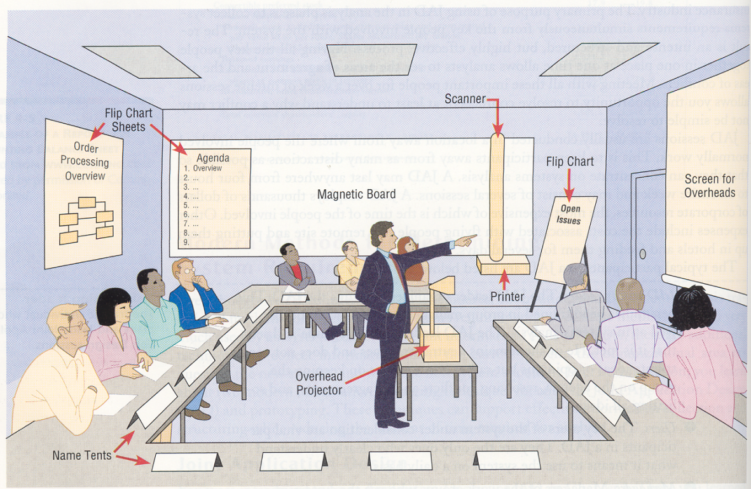
Figure-1 A typical room layout for a JAD session

Slide 32
Business Process Re-Engineering (BPR)
BPR means the search for, and implementation of, radical change is business processes to achieve breakthrough improvements in products and services.
BPR is a process in which existing methods of doing business are replaced with new and updated methods
In many business, the systems in place consists of programs that were written some time ago and still use old methods and technologies.
They often support only one business unit. These are called legacy systems
These systems were designed around the processes that took place in the business unit

Slide 33
In some organizations, the management is looking for new ways to perform current task , i.e.; to improve or change the way things are done- i.e.; to change the business processes.
This is called Business Process Re-engineering.
The overall process by which current methods are replaced with radically new methods is referred as BPR.
The new ways of doing things may be very different form the old ways, but the benefits may be big , since the processes become more efficient.
Since, the legacy systems were built around the business, a business re-engineering process often requires changes to the information systems

Slide 34
2.2 Prototyping
is a method that allows to quickly convert basic requirements into a working, though limited, version of the desired information system.
The user can view and test the prototype.
The goal of prototyping is to support requirements determination to develop concrete specifications for the ultimate system, not to build the ultimate system.
Prototyping is most useful in the following circumstances:
User requirements are not clear or well understood
Only one or a few users involved
Possible designs are complex
Communication problems have existed in the past, between users and analysts

Slide 35
It also has some disadvantages
Analysts may avoid creating formal documentation of the system
The prototype may be very influenced by the initial user who reviews it- and thus might not be adaptable to other users
Often build as a stand alone system, which may result in interfaces with other systems being ignored during this phase.

Slide 36
2. Structuring System Requirements
This is the second part next to requirement gathering in the system analysis phases of SDLC.
The information gathered during the requirements gathering process needs to be organized into a form that is a meaningful representation of the existing system and of the requirements for the new system.
This is done by:
Producing models of the processing elements and data transformations and
Then of the structure of the data.
This entire process is called structuring requirements
There are two stages in the structuring process:
1. Process Modeling-model using DFD Diagrams
2. Conceptual Data Modeling-model using ER-Diagram

Slide 37
Process modeling
involves graphically representing the processes, or actions that capture, manipulate, store and distribute data between a system and its environment and among the components within a system.
A common form of a process model is a Data Flow Diagram (DFD).
DFD is a graphic that illustrates:
The movement of data between external entities
The processes or actions within the system
And data stores within a system.
Modeling a system’s process:
Utilize information gathered during requirements determination
Structure of the data is also modeled in addition to the processes-done by data model

Slide 38
Deliverables and Outcomes
Set of coherent, interrelated data flow diagrams
Context data flow diagram (DFD)
Represents scope of system
DFDs of current system
Enables analysts to understand current system
DFDs of new logical system
Technology independent
Show data flows, structure and functional requirements of new system
Project dictionary and CASE repository
2. Conceptual Data Modeling
involves representing the data in a system or organization, to show the overall structure of the data.
A data model should be independent of any DBMS and of other implementation considerations.
Entity-Relationship Diagram(ER) data models are commonly used diagrams that show how data is organized in a system.

Slide 39
Data Flow Diagrams
The DFD is an excellent communication tool for analysts to model processes and functional requirements.
One of the primary tools of the structured analysis efforts of the 1970's it was developed and enhanced by the likes of Yourdon, McMenamin, Palmer, Gane and Sarson.
It is still considered one of the best modeling techniques for eliciting and representing the processing requirements of a system
Data Flow Diagramming Mechanics
DFD’s are versatile programming tools, with only four symbols, it can represent both physical and logical information systems.

Slide 40
1. Data Flow
The directional movement of data to and from external entities, the process and data stores.
If it flows into a data store, means a write, update, delete, etc.
Flows out of data stores, mean read, query , display, select types of transaction.
Symbol: Solid line with arrow. Each data flow is identified with a descriptive name that represents the information on the data flow.
Example: Registration Data
2. Process
is a work or actions performed on data so that they are transformed, stored, or distributed.
When modeling the data processing of a system, it doesn’t matter whether process is performed manually or by a computer.

Slide 41

Depending on the level of the diagram it may represent the whole system as in a Context (level 0) diagram or a business area, process (activity), function, etc in lower levels.
Symbol: Circle or a Rounded Rectangle
3. Data Store
A repository of information. In the physical model, this represents a file, table.
Symbol: Two parallel lines or open ended rectangle
Example.
2.0
Update
Students
detail

Slide 42
4. External Entity
It is a source/sink ( the origin and /or destination of the data).
A person or group which interacts with the system i.e.; something outside the system.
Example. Customer, supplier, government agency, accounting dept, etc. usually external to the business or system but may be internal
Data must be originated outside a system from one or more sources, and the system must produce information to one or more sinks.
Symbol: rectangular box which may be shaded.
Example:
Customer

Slide 43
Data Flow Diagramming Definitions
Context Diagram
A data flow diagram (DFD) of the scope of an organizational system that shows the system boundaries, external entities that interact with the system and the major information flows between the entities and the system
Level-O Diagram
A data flow diagram (DFD) that represents a system’s major processes, data flows and data stores at a high level of detail

Slide 44
Developing DFD’s
Example:-Develop DFD for Efrata Burger food ordering system
A context diagram is a DFD that provides a general overview of a system, other dfd’s can be used to focus the details of a context diagram.
This context diagram contains only one process, no data stores, four data flows, and three external entity.
The single process labeled “0”, represents the entire system.
All context diagrams have only one process labeled “0”.
No data stores appear on a context diagram, since the data stores of the system are conceptually inside the one process.

Slide 45
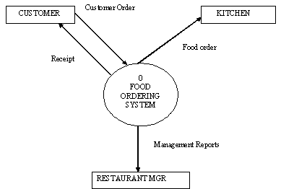
Figure-1 : Context diagram(Level-0) for Efrata Burger automated system

Slide 46
After drawing the context diagram, the next step is to analyze the processes are represented by the single process.
Four main processes are identified.
The processes represent the major functions of the system.
The major functions are:
Capturing data from different sources(process 1)
Maintaining data stores (process 2 and 3)
Producing and distributing data to different sinks (process 4)
High level descriptions of data transformation operations (process 1)

Slide 47
The flow from first process 1. are:
1) The food order is transmitted to the kitchen,
2) The customer order is transformed into a list of goods sold,
3) The customer order is transformed into inventory data, and
4) The process generates a receipt for the customer.
Two of the data flows generated by the process, receive and transform customer food order , go to external entities, not to concern about what happens outside of our system..
Figure-2 : Level 1- diagram of Efrata Burgers food ordering system

Slide 48
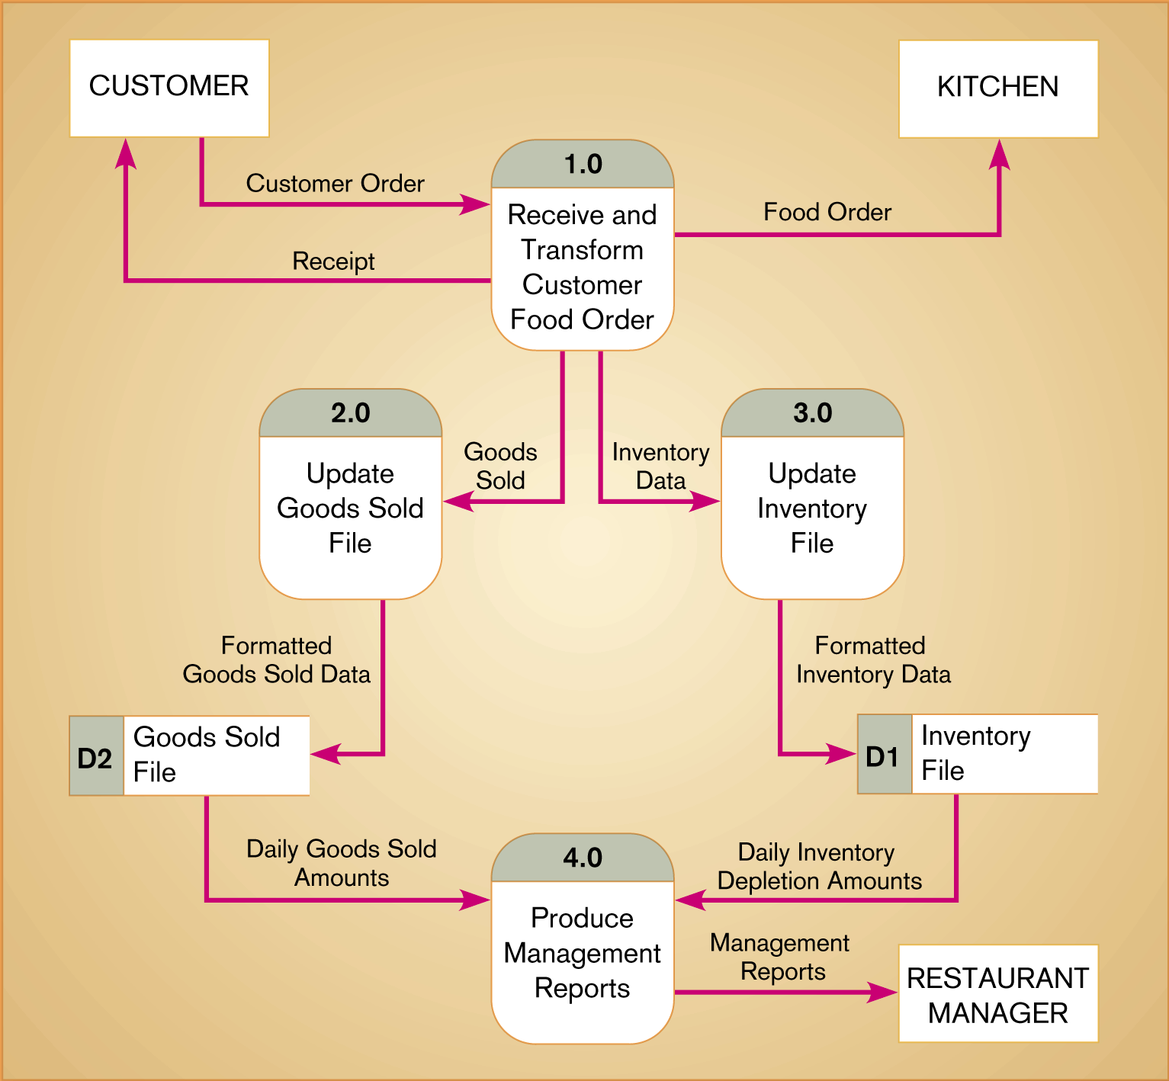

Slide 49
The data labeled Goods Sold go to process 2, update Goods Sold file.
The output for this process is labeled Formatted Goods Sold Data.
The output updates a data store labeled Goods Sold File.
Daily Goods Sold amounts are then used as input to process 4, Produce Management reports.
Similarly the data flow generated by process 1 called Inventory Data, serves as input for process 3, Update Inventory File.
The Daily Inventory Depletion amounts are then used as input to process 4.
The DFD hides the physical characteristics of the system it describes.
Process 1 and 3 are coupled to each other, since the data flow from process 1 must be readily accepted by process 3.
Process 2 and 4 are decoupled by placing a buffer, a data store.

Slide 50
Data Flow Diagramming Rules
Process
No process can have only outputs. It is making data from nothing.
If an object has only outputs, then it must be a source.
Incorrect Diagram Correct Diagram
B. No process can have only inputs.
If an object has only inputs, then it must be a sink

Slide 51


C. A process has a verb phrase label
Data Store
D. Data cannot move directly from one data source to another data source. Data must be moved by a process
E. Data cannot move directly from an outside source to a data store.
Data must be moved by a process that receives data from the source and places the data into the data store.

Slide 52

F. Data cannot move directly to an outside sink from a data store. Data must be moved by a process
G. A data store has a noun phrase label
External Entity (Source / Sink)
H. Data cannot move directly from a source to a sink.
They must be moved by a process if the data are of any concern to our system.
Otherwise, the data flow is not shown on the DFD.

Slide 53

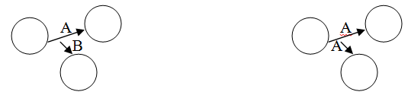
I. A source/sink has a noun phrase label
Data Flow
J. A data flow has only one direction of flow between symbols.
It may flow in both directions between a process and a data store to show a read before an update.
The latter is usually indicated, however by two separate arrows because these happen at different times.
K. A fork in a data flow means that exactly the same data go from a common location to two or more different processes, data stores, or sources/sinks.

Slide 54
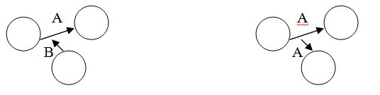
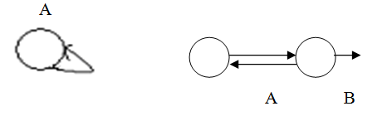
L. A join in a data flow means that exactly the same data come from any of two or more different processes , data stores, or sources/sinks to a common location
M. A data flow cannot go directly back to same process it leaves.
There must be at least one other process that handles the data flow, produces some other data flow, and returns the original data flow to the beginning process.

Slide 55
N. A data flow to a data store means update (delete or change)
O. A data flow from a data store means retrieve of use
P. A data flow has a noun phrase label.
More than one data flow noun phrase can appear on a single arrow as long as all of the flows on the same arrow move together as one package.

Slide 56
Decomposition of DFD’s
The act of going from a single system to more component processes is called decomposition
The functional decomposition is a repetitive process of breaking the system into finer and finer detail.
Each of the processes (or subsystem) is also candidate for decomposition.
Each process may consist of several sub processes.
Each sub process may also be broken down into smaller units.
Decomposition continues until no sub process can logically be broken down any further.
The lowest level of DFD is called primitive DFD.

Slide 57
The first process in the above figure-2 can be decomposed into four different processes.
Receive a customer order
2) Transform the entered order into a printed receipt for the customer
3) Transform the order into a form meaningful to the kitchens system
4) Transform the order into goods sold data, and
5) Transform the order into inventory data.
The decomposition of Process 1 is given in the next slide:

Slide 58
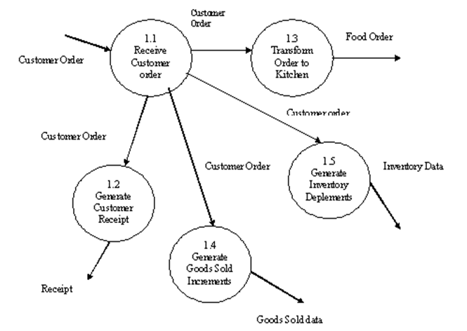
Figure-3 : Decomposition of Process 1 (Level-2)

Slide 59
The context and level-0 diagram will show the sources and sinks.
No sources or sinks are represented in figure-3.
We can decompose processes 2, 3, or 4 in a similar manner.
In general, a level-n diagram is a DFD that is generated is form n nested decompositions from a level-0 diagram.
As a rule of thumb, no DFD should have more than about seven processes in it.
The labels for the processes and numbering rules for clear communication, process names should be clear and concise, it may begin with an action verb, such as receive, calculate, transform, generate or produce.
Process 4 can be further decomposed into level-1, level-2 as given in the next slide:

Slide 60
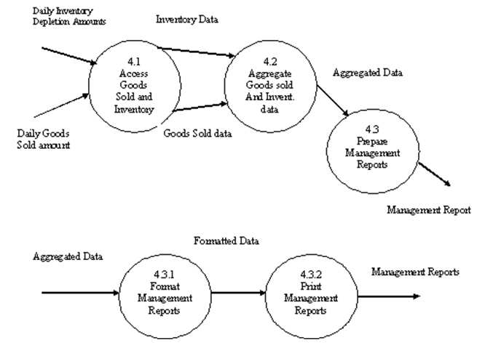
Figure-4 : level-1 and level-2 DFDs of Process 4.0

Slide 61
Balancing DFDs
The conservation of inputs and outputs to a data flow diagram process when that process is decomposed to a lower level.
For Example: Process 1, which appears in a level-0 diagram, must have the same inputs and outputs when decomposed into a level-1 diagram is called balancing.
The principle of balancing and goal of keeping a DFD as simple as possible lead to four additional, advanced rules for drawing DFDs:
1. A composite data flow on one level can be split into component data flows at the next level.
But no new data can be added and all data in the composite must be accounted for in one or more sub flows.

Slide 62
2. The input to a process must be sufficient to produce the outputs from the process.
Thus all outputs can be produced, and all data in inputs move somewhere, either to another process or to a data store outside the process or on a more detailed DFD showing a decomposition of that process.
3. At the lowest level of DFDs, new data flows may be added to represent data that are transmitted under exceptional conditions.
These data flows typically represent error messages or confirmation notices.
4. To avoid having data flow lines cross each other, you may repeat data store or entities on a DFD.
Use an additional symbol, like a double line on the middle vertical line of a data store symbol, or a diagonal line in a corner of a entity square, to indicate a repeated symbol.

Slide 63
Additional Guidelines for Drawing DFDs
Completeness:
DFDs include all the components necessary for the system you are modeling.
If the DFD contains data flows that do no lead anywhere, or data store, processes, or external entities that are not connected to anything else, that DFD is not complete.
2. Consistency:
It refers to whether or not the depiction of the system shown at one level of a DFD is compatible with the depictions of the system shown at other level.
A gross violation of consistency would be a level-1 diagram with no level-0 diagram.
Another example of inconsistency would be a data flow that appears on higher level DFD but not on lower levels.

Slide 64
3. Timing considerations:
On a given DFD, there is no indication of whether a data flow occurs at what time and there is also no indication of when a system would run.
When you draw DFDs, then draw them as if the system you are modeling has never started and will never stop.
4. The iterative nature of drawing DFDs:
Iterative development recognizes that requirements determination and requirements structuring are interaction, not sequential, sub-phases of the analysis phase of the SDLC.
One rule of thumb is that it should take you about three revisions for each DFD.

Slide 65
5. Drawing primitive DFDs:
The lowest level DFD is the primitive DFD.
One rule is to stop drawing when the lowest logical level is reached.
It is not easy to know what the lowest level is, hence few concrete rules for when to stop decomposing are:
When you have reduced each processes to a single decision or calculation or to a single database operation such as retrieve, update, create or delete.
When each data store represents data about a single entity, such as customer, employee, product, or order
When every data flow does not need to be split further to show that different data are handled in various ways
When there is a separate process for each choice on all lowest-level menu options.

Slide 66
Using Data flow Diagramming in the Analysis Process
Gap Analysis: The process of discovering discrepancies between two or more sets of data flow diagrams or discrepancies within a single DFD.
DFD can be used for gap analysis.
Once DFD is completed , it is examined for problems like:
Redundant data flows,
Data that are captured but not used by the system, and
Data are updated identically in more than one location

Slide 67
Conceptual Data Modeling
An Entity-Relationship Diagram(ERD):
a graphical representation of entities, attributes, constraints and their relationships to each other
describes the organization of data within databases or information systems.
ER diagram expresses the overall logical structure of a database graphically.
Entity Relationship Diagrams are a major data modeling tool and will help organize the data in your project into entities and define the relationships between the entities.
This process has proved to enable the analyst to produce a good database structure so that the data can be stored and retrieved in a most efficient manner.

Slide 68
Components of ER-Diagram
1. Entity
A data entity is anything real or abstract about which we want to store data.
Entity types fall into five classes:
Roles, Events
Locations, Tangible things , Concepts.
E.g. employee, payment, campus, book. Specific examples of an entity are called instances.
E.g. the employee John Jones, Mary Smith's payment, etc.
2. Relationship
A data relationship is a natural association that exists between one or more entities.
E.g. Employees process payments.

Slide 69
There are three common types of relationships between entities:
A. One-to-one:
One instance of an entity (A) is associated with one instance of another entity (B) and viseversal.
For example, in a database of employees:
Each employee name is associated with only one social security number and only one security number is given to one employee.
B. One-to-Many:
One instance of an entity (A) is associated with zero, one or many instances of another entity (B).
But for one instance of entity B there is only one instance of entity A.

Slide 70
For example:
For a company with all employees working in one building, the building name is associated with many different employees.
But those employees all share the same singular association of a building.
C. Many-to-many:
One instance of an entity (A) is associated with one, zero or many instances of another entity (B).
And one instance of entity B is associated with one, zero or many instances of entity A.
For example, for a company in which all of its employees work on multiple projects:
Each instance of an employee is associated with many instances of a project.
And each instance of a project has multiple employees associated with it.

Slide 71
3. Cardinality defines the number of occurrences of one entity for a single occurrence of the related entity.
E.g. an employee may process many payments but might not process any payments depending on the nature of her job.
4. Attribute
is a properties that stores information about an entity.
Synonyms include property, data element, field.
E.g. Name, address, Employee Number, pay rate are all attributes of the entity employee.
An attribute or combination of attributes that uniquely identifies one and only one instance of an entity is called a primary key or identifier.
E.g. Employee Number is a primary key for Employee
The following three symbols are used to indicate entity, relationships and attributes:

Slide 72
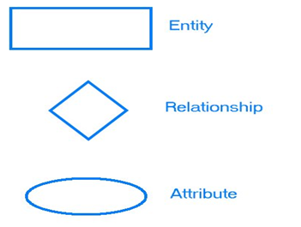

Slide 73
AN ENTITY RELATIONSHIP DIAGRAM METHODOLOGY-(One way of doing it)
1.Identify Entities | Identify the roles, events, locations, tangible things or concepts about which the end-users want to store data.
2. Find Relationships | Find the natural associations between pairs of entities using a relationship matrix.
3. Draw Rough ERD | Put entities in rectangles and relationships on line segments connecting the entities
4. Fill in Cardinality | Determine the number of occurrences of one entity for a single occurrence of the related entity
5. Define Primary Keys | Identify the data attribute(s) that uniquely identify one and only one occurrence of each entity

Slide 74
6. Draw Key-Based ERD | Eliminate Many-to-Many relationships and include primary and foreign keys in each entity
7. Identify Attributes | Name the information details (fields) which are essential to the system under development
8. Map Attributes | For each attribute, match it with exactly one entity that it describes
9. Draw fully attributed ERD | Adjust the ERD from step 6 to account for entities or relationships discovered in step 8
10. Check Results | Does the final Entity Relationship Diagram accurately depict the system data?

Slide 75
A SIMPLE EXAMPLE
A company has several departments. Each department has a supervisor and at least one employee. Employees must be assigned to at least one, but possibly more departments. At least one employee is assigned to a project, but an employee may be on vacation and not assigned to any projects. The important data fields are the names of the departments, projects, supervisors and employees, as well as the supervisor and employee number and a unique project number.
1. Identify Entities
The entities in this system are Department, Employee, Supervisor and Project.
One is tempted to make Company an entity, but it is a false entity because it has only one instance in this problem. True entities must have more than one instance.
2. Find Relationships
We construct the following Entity Relationship Matrix:

Slide 76
Department run by Supervisor
Employee is assigned to Department
Employee Works on a Project

Slide 77
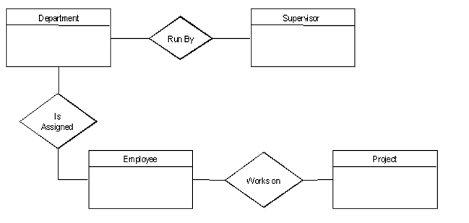
3. Draw Rough ERD
We connect the entities whenever a relationship is shown in the entity Relationship Matrix.

Slide 78
4. Fill in Cardinality
From the description of the problem we see that:
Each department has exactly one supervisor.
A supervisor is in charge of one and only one department.
Each department is assigned at least one employee.
Each employee works for at least one department.
Each project has at least one employee working on it.
An employee is assigned to 0 or more projects.

Slide 79
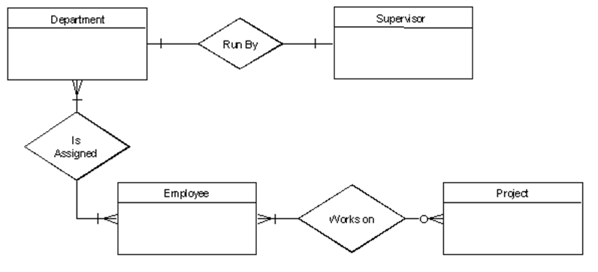

Slide 80
5. Define Primary Keys
The primary keys are Department Number, Supervisor Number, Employee Number, Project Number.
6. Draw Key-Based ERD
There are two many-to-many relationships in the rough ERD above:
Between Department and Employee and
Between Employee and Project.
Thus we need the associative entities Department-Employee and Employee-Project.
The primary key for Department-Employee is the concatenated key Department Number and Employee Number.
The primary key for Employee-Project is the concatenated key Employee Number and Project Number.

Slide 81
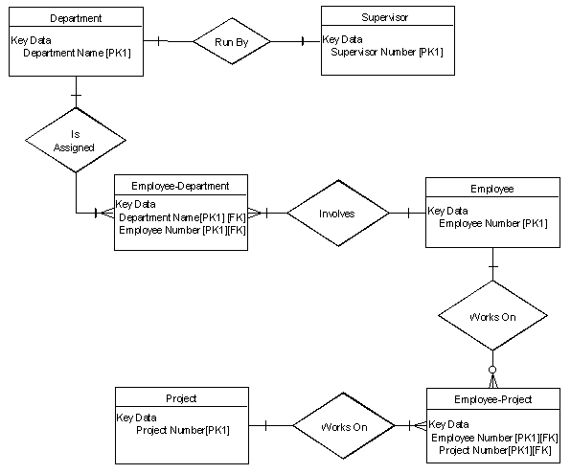

Slide 82
7. Identify Attributes
The only attributes indicated are the names of the departments, projects, supervisors and employees, as well as the supervisor and employee NUMBER and a unique project number.
8. Map Attributes
Attribute | Entity | Attribute | Entity
Department Name | Department | Supervisor Number | Supervisor
Employee Number | Employee | Supervisor Name | Supervisor
Employee Name | Employee | Project Name | Project
 |  | Project Number | Project

Slide 83
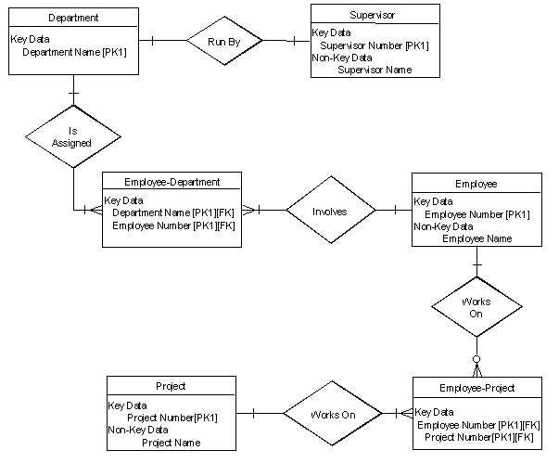
9. Draw Fully Attributed ERD

Slide 84
10. Check Results
The final ERD appears to model the data in this system well.
Summary
Step 1. Identify Entities
A data entity is anything real or abstract about which we want to store data. Entity types fall into five classes: roles, events, locations, tangible things, or concepts.
The best way to identify entities is to ask the system owners and users to identify things about which they would like to capture, store and produce information.
Another source for identifying entities is to study the forms, files, and reports generated by the current system.
E.g. a student registration form would refer to Student (a role), but also Course (an event), Instructor (a role), Advisor (a role), Room (a location), etc.

Slide 85
Step 2. Find Relationships
There are natural associations between pairs of entities.
Listing the entities down the left column and across the top of a table, we can form a relationship matrix by filling in an active verb at the intersection of two entities which are related.
Each row and column should have at least one relationship listed or else the entity associated with that row or column does not interact with the rest of the system.
In this case, you should question whether it makes sense to include that entity in the system.
A student is enrolled in one or more courses subject verb objects

Slide 86
Step 3. Draw Rough ERD
Using rectangles for entities and lines for relationships, we can draw an Entity Relationship Diagram (ERD).
Step 4. Fill in Cardinality
At each end of each connector joining rectangles, we need to place a symbol indicating the minimum and maximum number of instances of the adjacent rectangle there are for one instance of the rectangle at the other end of the relationship line.
The placement of these numbers is often confusing.
The first symbol is either 0 to indicate that it is possible for no instances of the entity joining the connector to be related to a given instance of the entity on the other side of the relationship, 1 if at least one instance is necessary or it is omitted if more than one instance is required.

Slide 87
For example, more than one student must be enrolled in a course for it to run, but it is possible for no students to have a particular instructor (if they are on leave).
The second symbol gives the maximum number of instances of the entity joining the connector for each instance of the entity on the other side of the relationship. If there is only one such instance, this symbol is 1.
If more than 1, the symbol is a crows foot opening towards the rectangle.
If you read it like a sentence, the first entity is the subject, the relationship is the verb, the cardinality after the relationship tells how many direct objects (second entity) there are.
I.e. A student is enrolled in one or more courses subject verb objects

Slide 88
Step 5. Define Primary Keys
For each entity we must find a unique primary key so that instances of that entity can be distinguished from one another. Often a single field or property is a primary key (e.g. a Student ID).
Other times the identifier is a set of fields or attributes (e.g. a course needs a department identifier, a course number, and often a section number; a Room needs a Building Name and a Room Number).
When the entity is written with all its attributes, the primary key is underlined.
Step 6. Draw Key-Based ERD
Looking at the Rough Draft ERD, we may see some relationships which are non-specific or many-to-many. I.e., there are crows feet on both ends of the relationship line.

Slide 89
Such relationships spell trouble later when we try to implement the related entities as data stores or data files, since each record will need an indefinite number of fields to maintain the many-to-many relationship.
Fortunately, by introducing an extra entity, called an associative entity for each many-to-many relationship, we can solve this problem.
The new associative entity's name will be the hyphenation of the names of the two originating entities.
It will have a concatenated key consisting of the keys of these two entities.
It will have a 1-1 relationship with each of its parent entities and each parent will have the same relationship with the associative entity that they had with each other before we introduced the associative entity.
The original relationship between the parents will be deleted from the diagram.
The key-based ERD has no many-to-many relationships and each entity has its primary and foreign keys listed below the entity name in its rectangle

Slide 90
Step 7. Identify Attributes
A data attribute is a characteristic common to all or most instances of a particular entity.
In this step we try to identify and name all the attributes essential to the system we are studying without trying to match them to particular entities.
The best way to do this is to study the forms, files and reports currently kept by the users of the system and circle each data item on the paper copy.
Cross out those which will not be transferred to the new system, extraneous items such as signatures, and constant information which is the same for all instances of the form (e.g. your company name and address).
The remaining circled items should represent the attributes you need.

Slide 91
You should always verify these with your system users. (Sometimes forms or reports are out of date.)
Step 8. Map Attributes
For each attribute we need to match it with exactly one entity. Often it seems like an attribute should go with more than one entity (e.g. Name).
In this case you need to add a modifier to the attribute name to make it unique (e.g. Customer Name, Employee Name, etc.) or determine which entity an attribute "best' describes.
If you have attributes left over without corresponding entities, you may have missed an entity and its corresponding relationships. Identify these missed entities and add them to the relationship matrix now.
Step 9. Draw Fully-Attributed ERD
If you introduced new entities and attributes in step 8, you need to redraw the entity relationship diagram.
When you do so, try to rearrange it so no lines cross by putting the entities with the most relationships in the middle.

Slide 92
If you use a tool like Systems Architect, redrawing the diagram is relatively easy.
Even if you have no new entities to add to the Key-Based ERD, you still need to add the attributes to the Non-Key Data section of each rectangle.
Adding these attributes automatically puts them in the repository, so when we use the entity to design the new system, all its attributes will be available.
Step 10. Check Results
Look at your diagram from the point of view of a system owner or user.
Is everything clear? Check through the Cardinality pairs.
Also, look over the list of attributes associated with each entity to see if anything has been omitted.

